Slide 1

The Solver Team
Sireesha Chimbili
Pooja Donuru
Rathna Nidamanuri

Slide 2
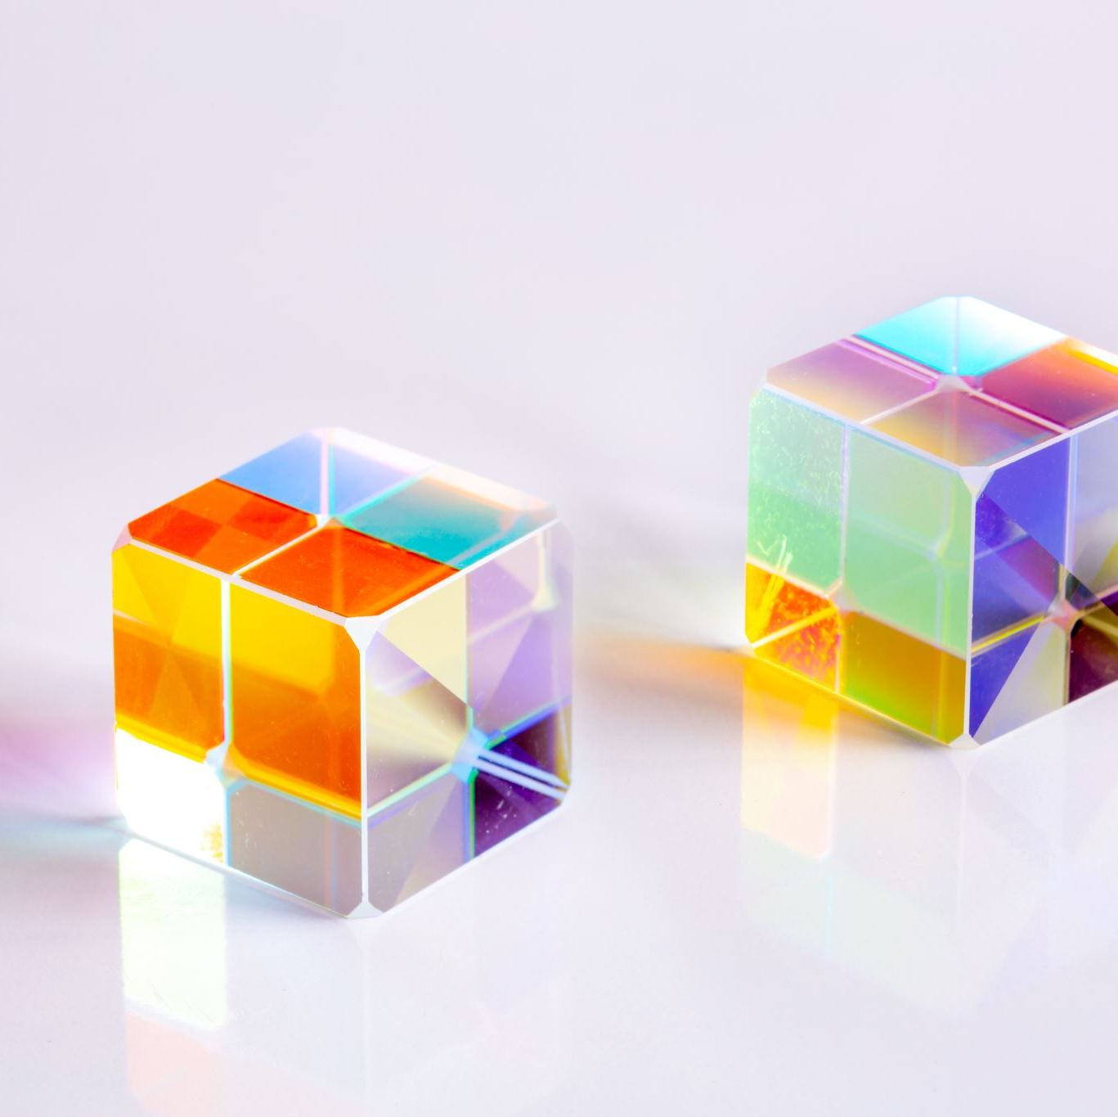
Topic
Reinforcement Learning for Rubik’s Cube(3*3*3)

Slide 3
Table of Contents
Objectives
Introduction
Approach
Algorithm
Implementation
Results
Conclusion
Deliverables

Slide 4
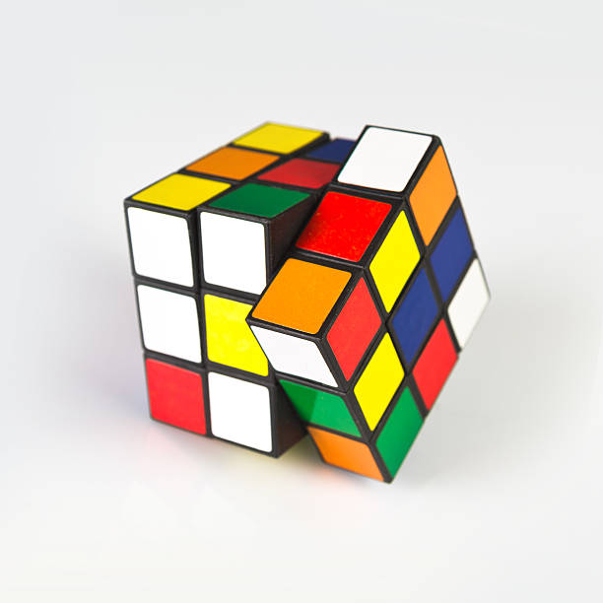
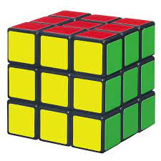
Rubik’s Cube (3*3*3)
The Rubik’s cube of dimension(3*3*3) has 6 faces represented as (front, back, left, right, top, bottom) each face having 9 blocks of each having a color.
The cube has 12 edges, 8 Corners, 6 centers.
The Goal state is achieved when the cube is solved with each side having the same color on all the 6 sides.

Slide 5
Objectives
To Solve Rubik Cube of Dimension 3*3*3 without Human Knowledge and by training the agent using the Feature based state representations.
Our goal is to Solve the Cube in a smaller number of moves and less span of time.

Slide 6
Approach
We have used Model-free Reinforcement Learning algorithm called Feature based Q-learning and the utilization of the pattern Database to check the quality of the nearly-finished states of the cube.
The Q-learning algorithm and epsilon-greedy policy is used to decide the optimal move based on the Q-values and the reward associated based on the discount factor in the given number of episodes with the given learning rate.
Feature-based Q learning is used by the agent to solve the cube in the given number of episodes and agent stops after reaching the goal state (Solved Cube).

Slide 7
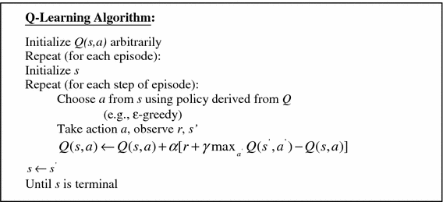
Feature based Q-learning Algorithm

Slide 8
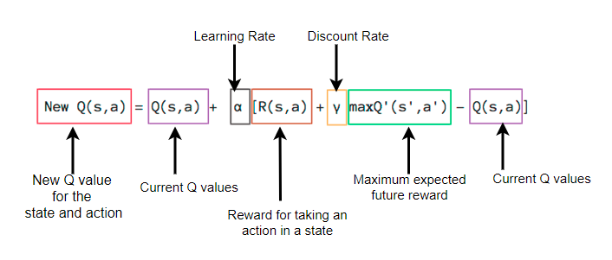
Choosing the Q-value:

Slide 9
Implementation
Agent is trained with the Solved State(Goal).
Initialized with the Discount rate, Learning rate, epsilon, number of episodes.
Register the Input unsolved state and assign random Q-values initially.
Calculate the Q-value at each stage and select the best Q-value based on the Maximum reward returned and chosen the best action.

Slide 10
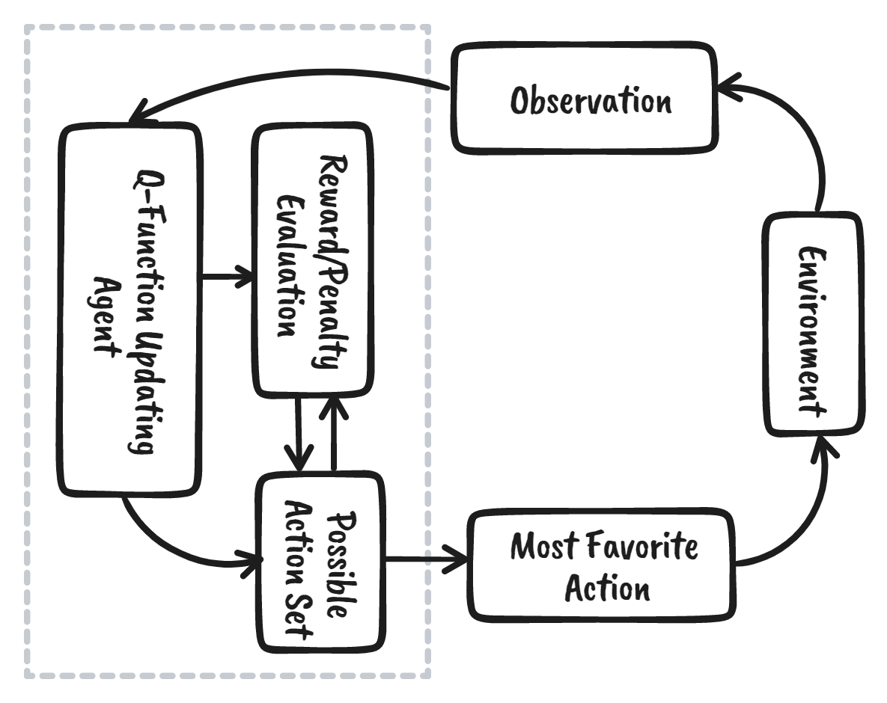
Flow Graph

Slide 11
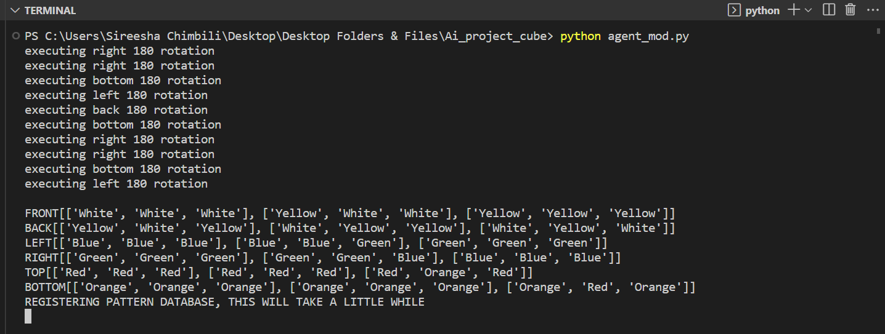
Initialized Unsolved Cube

Slide 12
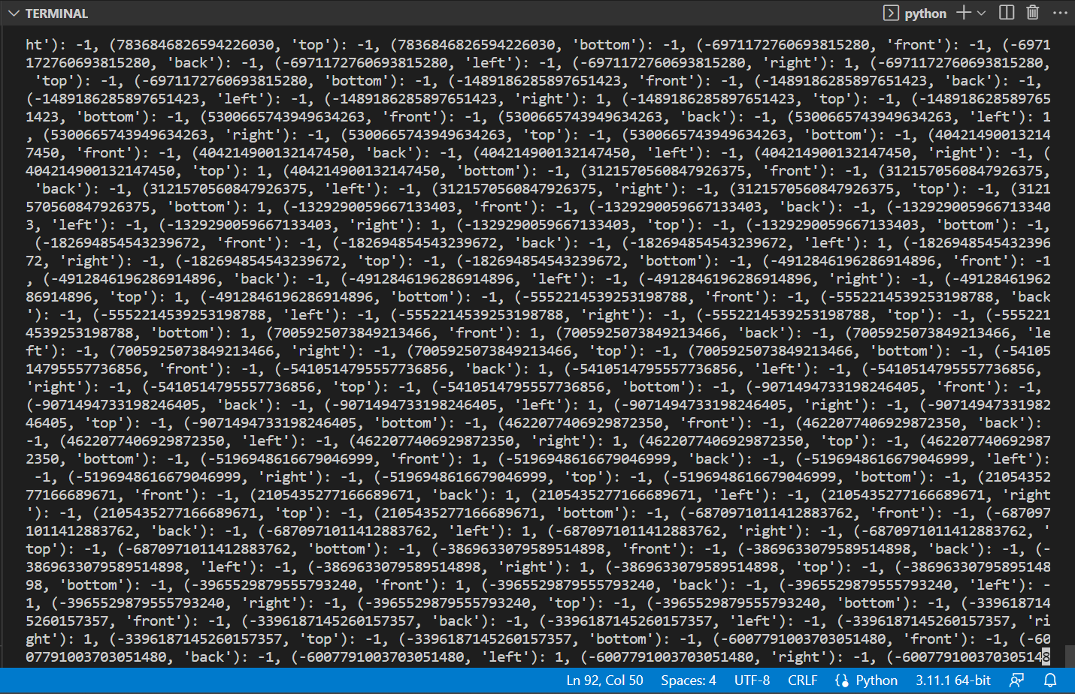
Training Stage and Calculating Q-Values

Slide 13
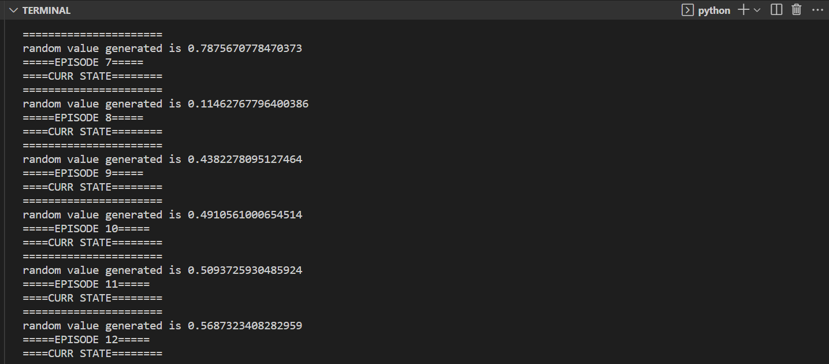
Snapshot of working in different episodes

Slide 14
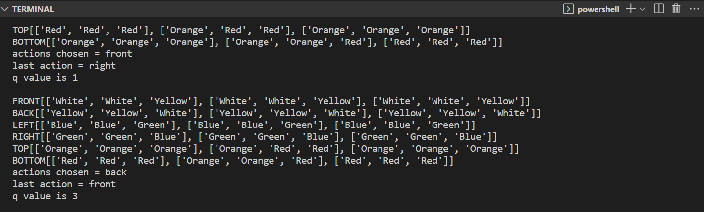
Pre-stages of Solving the Cube

Slide 15
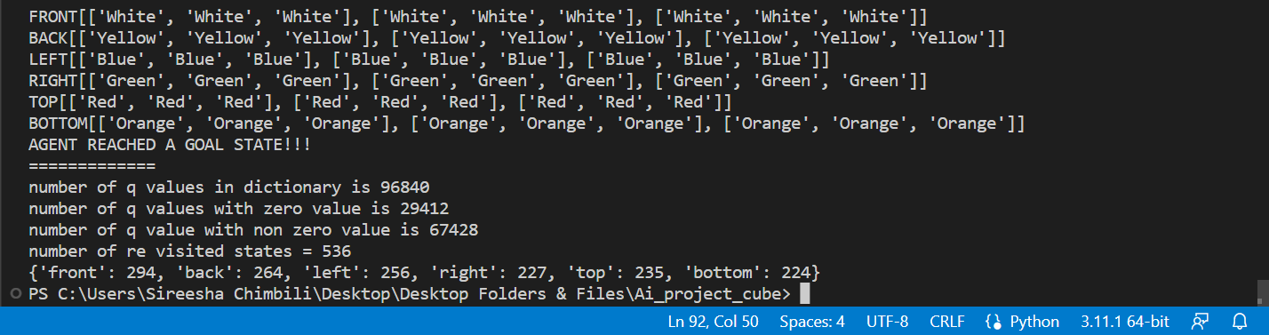
Solved Cube by the Agent

Slide 16
Evaluation Methodology
Reward Maximization. (Chosen the best action at each stage based on the Max Reward)
Accuracy ( 100% accuracy with <20 shuffled states)
Completion Time (<50 seconds)
Scalability (Works better with 4*4*4 cube too)
Complexity

Slide 17
Conclusion
The Agent is trained to solve the Rubik’s cube 3*3*3 using the Feature based Q-learning (Model-free Reinforcement Learning Algorithm).
The Agent chooses the best action based on the Q-value and the maximum reward associated with the action chosen by the agent.
The Cube with shuffled states <20 has been solved by the agent within 40 seconds of time and the agent stops the play after it reached the goal state (Solved Cube).

Slide 18



Deliverables
Code Repository
Contains the Source Code, any supporting data files used to develop the models and train the agent.
Technical Documentation Documenting the technical aspects of the Project which includes the Model Architecture, Training Methodology.
Final Presentation report
A detailed report summarizing the project objectives, approach, methodology, results, and conclusions.
YouTube Video
The Detailed Video showcasing the Working of the agent Solving the Cube and the results associated with it.

Slide 19

Thank You

